Slide 1


Software Quality Engineering (Week-4)
Usama Musharaf
LECTURER (Department of Computer Science)
FAST-NUCES Peshawar

Slide 2
Content of Week # 4
Quality Attributes:
Scalability

Slide 3
Scalability

Slide 4
Performance vs Scalability
FIXED LOAD
Performance
Low Latency
High Throughput
Concurrency
Single-Machine- Multi-Threading
Multi-Machine- Multi-Threading + Multiprocessing = Distributed Processing
VARIABLE LOAD
Scalability
High Throughput
Ability of a system to increase its throughput by adding more hardware capacity.
Both Ways: Up and Down

Slide 5
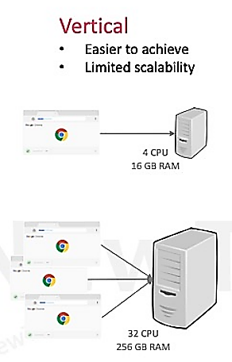
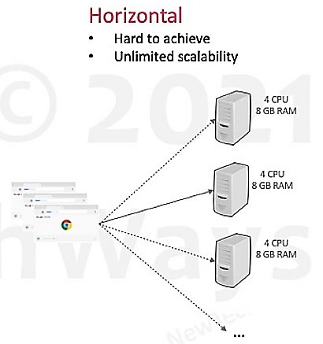
Vertical & Horizontal Scalability

Slide 6
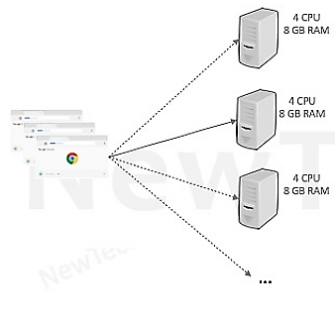
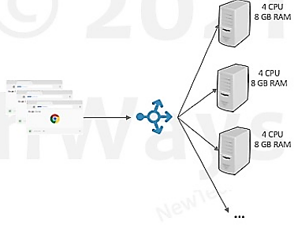
Reverse Proxy
Client needs to know only about the address of the Reverse Proxy.
Reverse proxy can also act as load balancer.

Slide 7
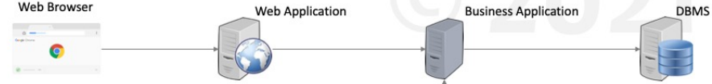
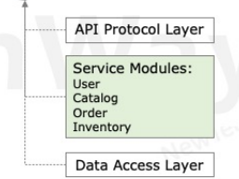
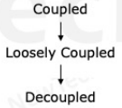
Modularity
Scalable architecture starts with Modularity
Provides the foundation for breaking an application into more specialized functions/services.

Slide 8
Horizontal Scaling Methods
Services
Replication
Stateful
Stateless
Portioning
Vertical / Functionality Portioning
Database portioning
Asynchronous Calls

Slide 9
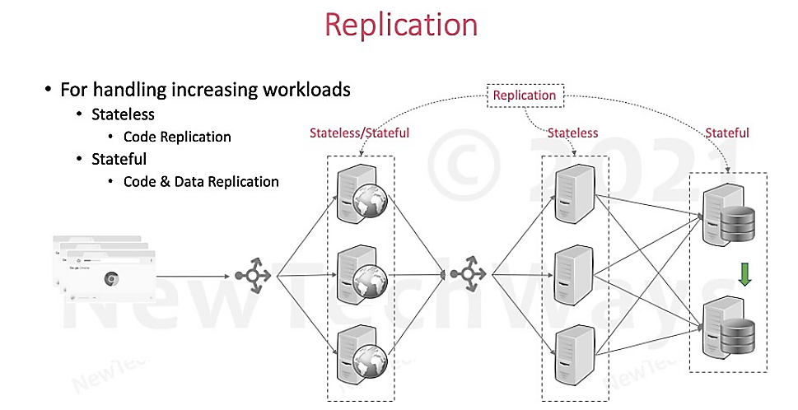

Slide 10
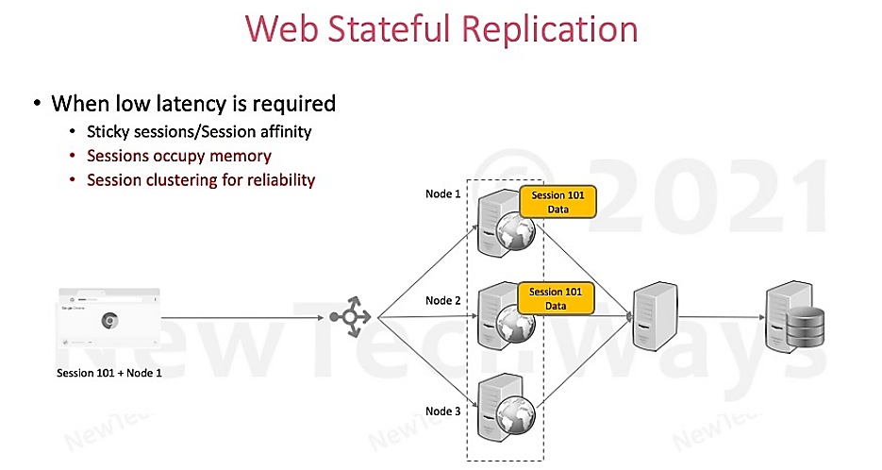

Slide 11
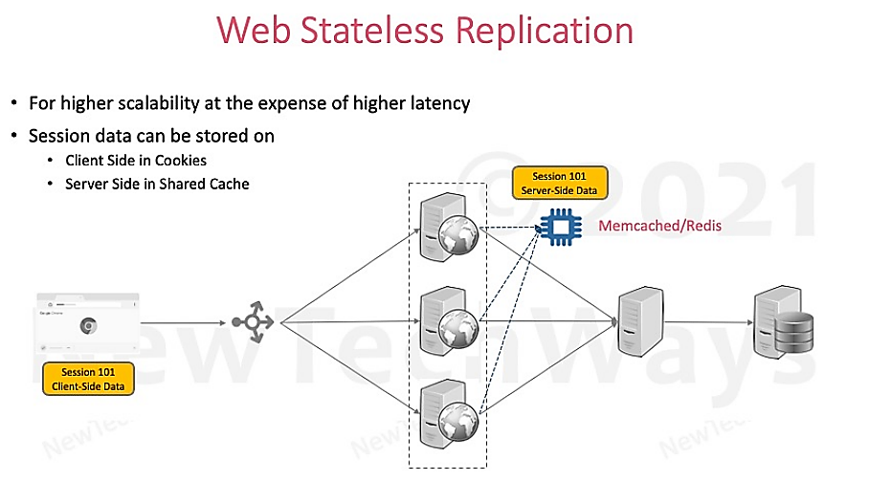

Slide 12
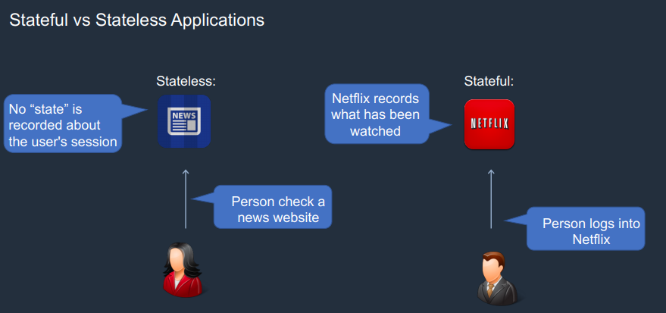

Slide 13
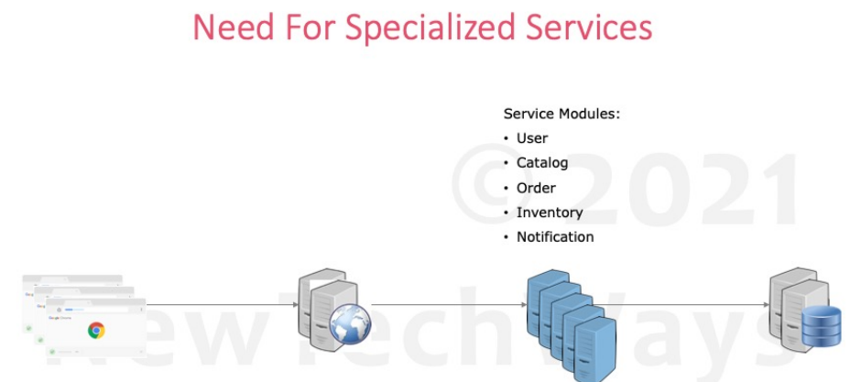

Slide 14
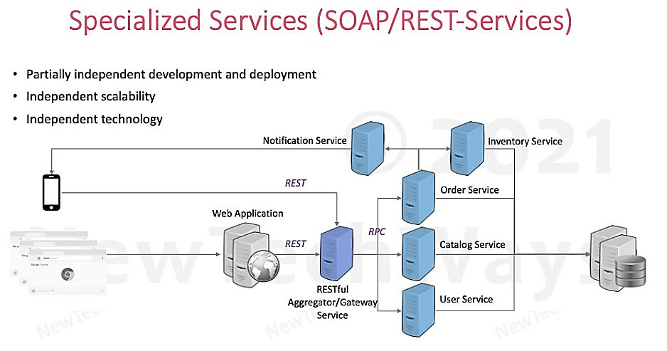

Slide 15
Representational state transfer (REST)
REST, or REpresentational State Transfer, is an architectural style for providing standards between computer systems on the web, making it easier for systems to communicate with each other.
REST is a guideline for building performant and scalable applications.

Slide 16
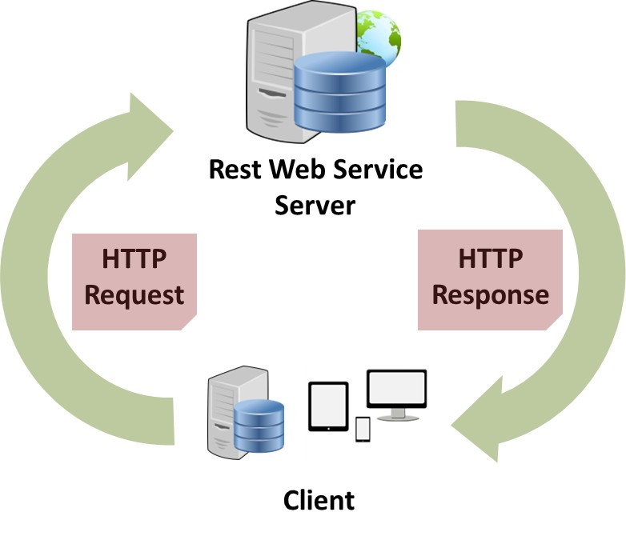
Representational State Transfer (REST)
Representational State Transfer (REST)
A style of software architecture for distributed systems such as the World Wide Web.
REST is basically client/server architectural style
Requests and responses are built around the transfer of "representations" of "resources".
HTTP is the main and the best example of a REST style implementation
But it should not be confused with REST
REST is not a protocol
REST is a guideline

Slide 17
REST principles / architectural constraints
Client-server
Stateless
Cacheable
Uniform interface
Layered system
Code on demand (optional)

Slide 18
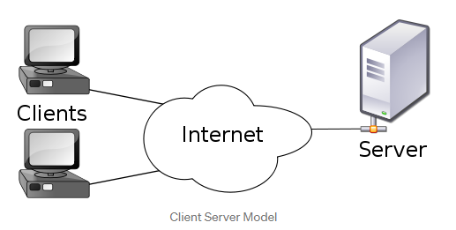
1. Client Server
Separation of concerns is the principle behind the client-server constraints.
By separating the user interface concerns from the data storage concerns, we improve the portability of the user interface across multiple platforms and improve scalability by simplifying the server components.
Client and server can evolve independently.

Slide 19
2. Stateless
Statelessness means communication must be stateless in nature as in the client stateless server style,
Each request from client to server must contain all of the information necessary to understand the request, and cannot take advantage of any stored context on the server.

Slide 20
3. Cacheable
In order to improve network efficiency, cache constraints are added to the REST style.
Cache constraints require that the data within a response to a request can be cacheable or not
If a response is cacheable, then a client cache is given the right to reuse that response data for later, equivalent requests.
The advantage of adding cache constraints is that they have the potential to partially or completely eliminate some interactions, improving efficiency, scalability, and user-perceived performance by reducing the average latency of a series of interactions.

Slide 21
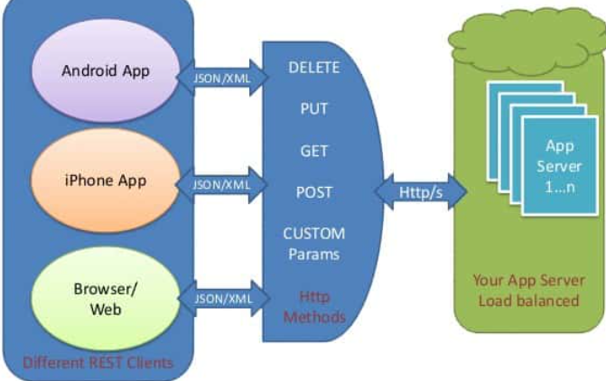
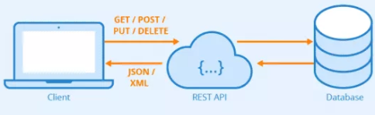
4. Uniform interface
Identification of resources (typically by URI).
Manipulation of resources through representations.

Slide 22
5. Layered system
The layered system style allows an architecture to be composed of hierarchical layers by constraining component behavior such that each component cannot “see” beyond the immediate layer with which they are interacting.

Slide 23
6. Code on demand (optional)
This states that the server can add more functionality to the REST client, by sending code that can be executable by that client. In the context of the web, one such example is JavaScript code that the server sends to the browser.
For example, a web browser acts like a REST client and the server passes HTML content that the browser renders. At the server side, there is some sort of server-side language which is performing some logical work at the server side. But if we want to add some logic which will work in the browser then we (as server-side developers) will have to send some JavaScript code to the client side and the browser and then execute that JavaScript.

Slide 24
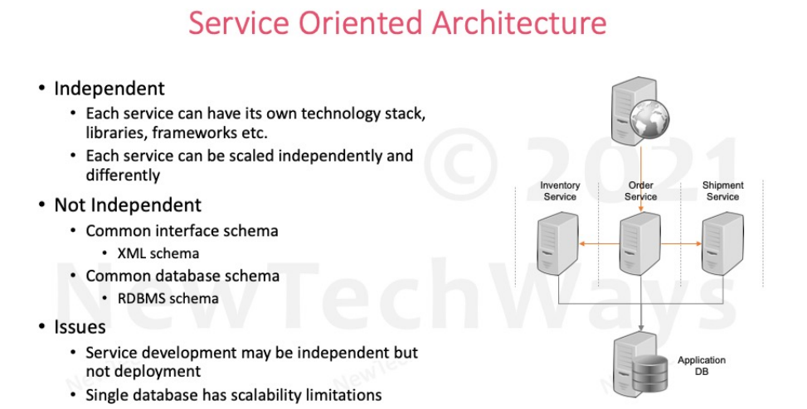

Slide 25
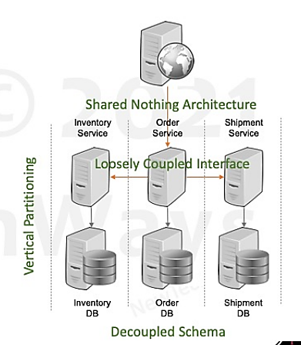
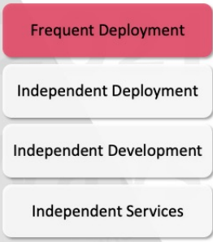
Microservices

Slide 26
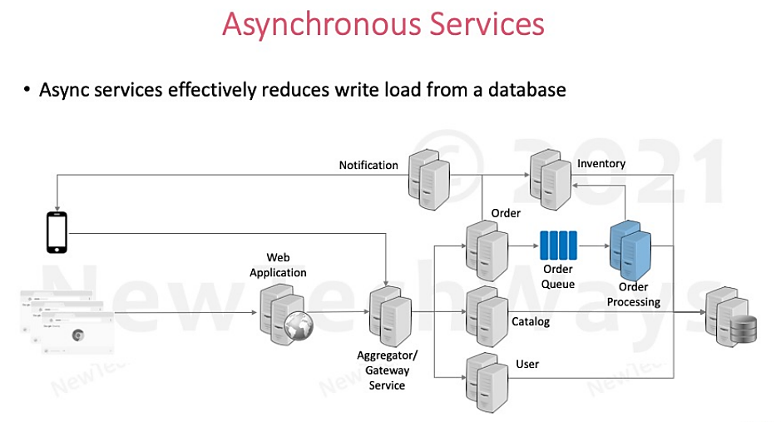

Slide 27
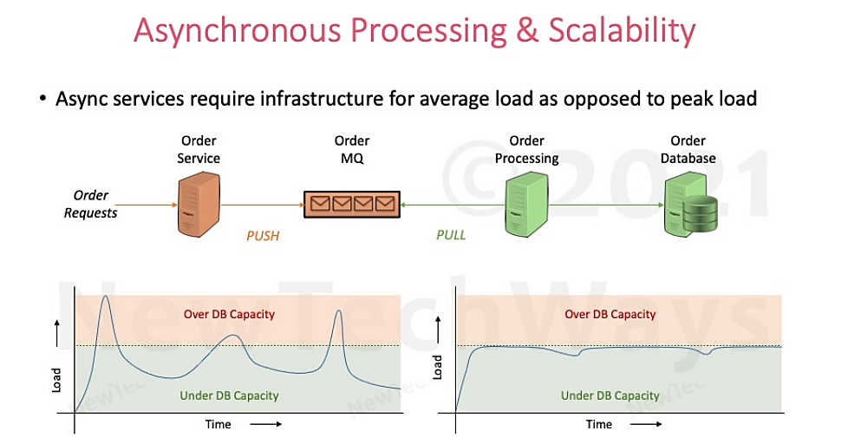

Slide 28
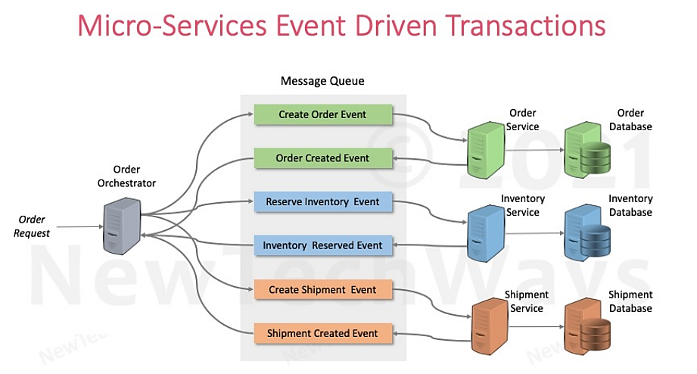

Slide 29
HAVE A GOOD DAY !

